Slide 1

PAST CONTINUOUS

Slide 2
What were they doing at 9 o’clock?
 | Susan & David | John | Mary | Tom & Ann
8:00 – 8:45 | MATHS | ENGLISH | PE | GEOGRAPHY
8:50 – 9:35 | PE | ART | MUSIC | HISTORY
9:40 – 10:25 | GEOGRAPHY | GERMAN | ENGLISH | ART
Susan and David were playing volleyball.
John was _______________.
Mary _________________ the flute.
Tom and Ann ________________ about British kings and queens.
painting
was playing
were studying

Slide 3

past actions that were in progress at a particular time in the past
He was painting.
They were studying.
9 o’clock

Slide 4

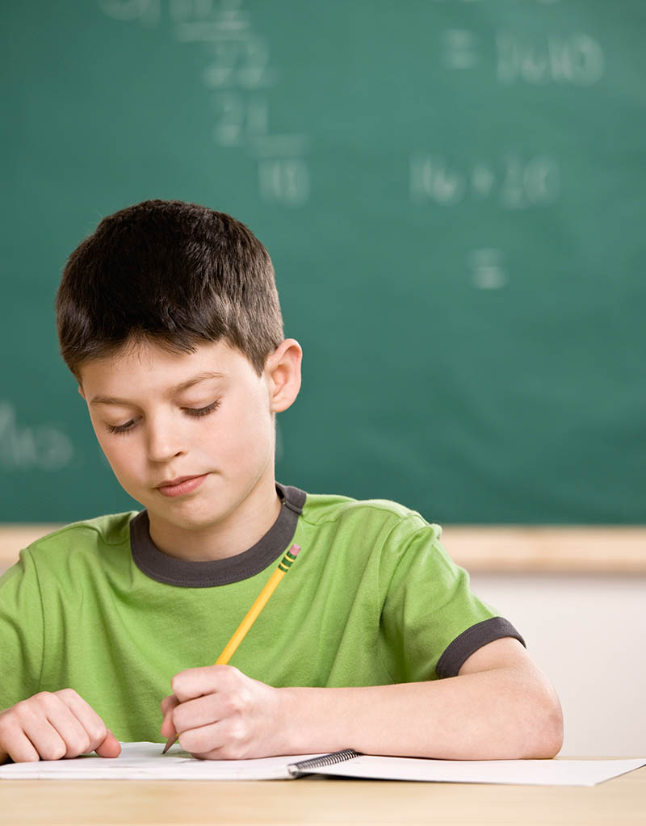
My sister _____________ while my brother _____________for the test.
was reading
was studying
My brother
My sister
read
study for the test

Slide 5
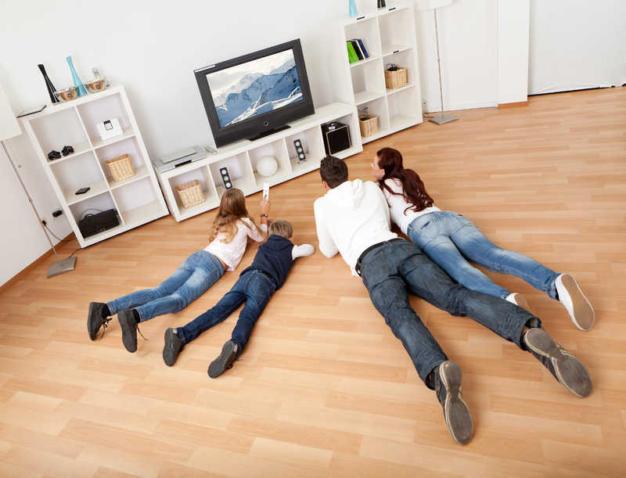
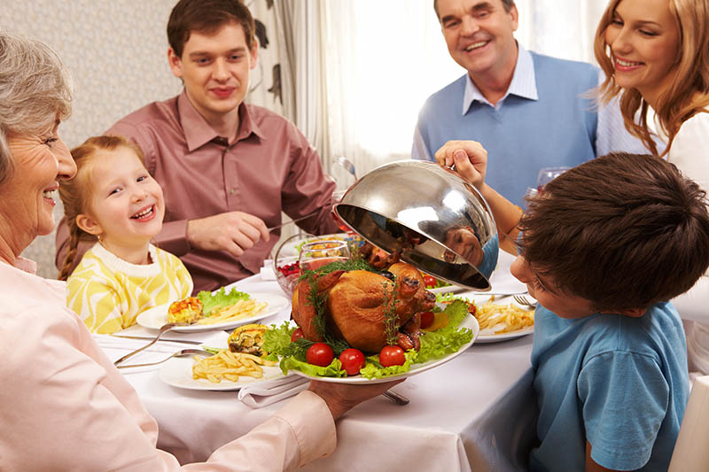
The Browns _________________ while the Taylors ___________________.
were watching TV
were having dinner
The Browns
The Taylors
watch TV
have dinner

Slide 6

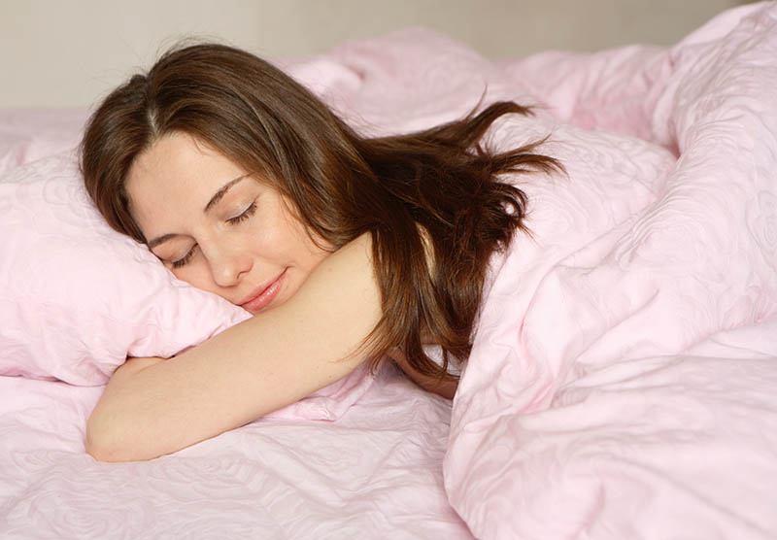
While ______________, my friend ________________________.
I was sleeping
was listening to music
I
My friend
sleep
listen to music

Slide 7
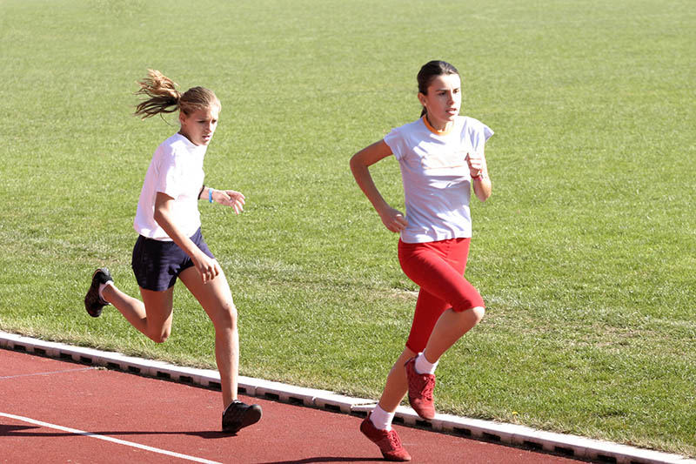
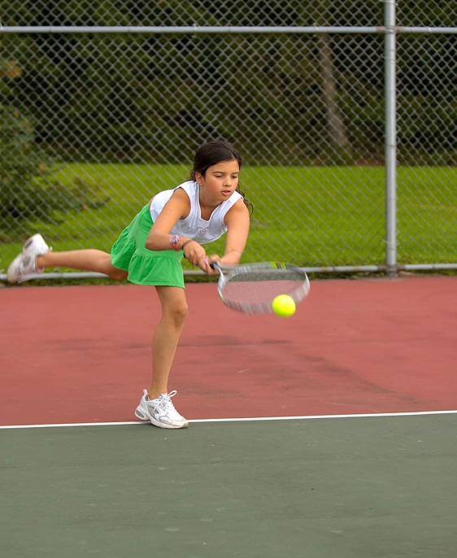
While _____________________, ________________________.
we were running
you were playing tennis
we
you
run
play tennis

Slide 8
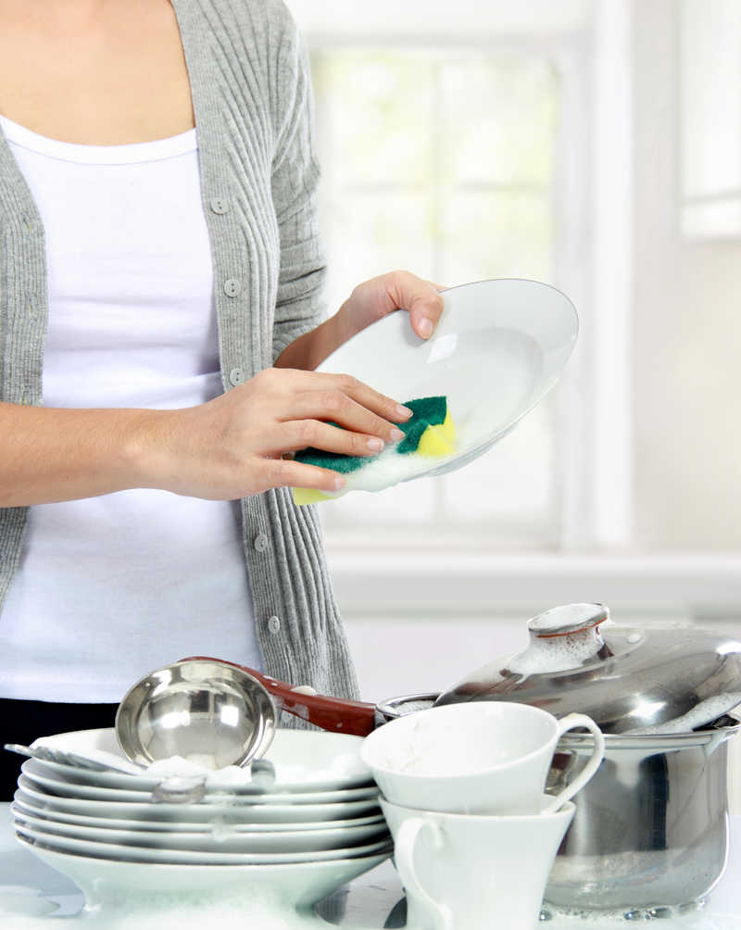
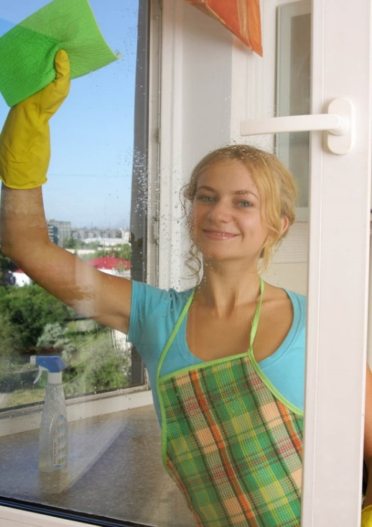
___________________________ while ________________________________.
Miss White was washing up
Mrs Smith was cleaning the window
Miss White
Mrs Smith
wash up
clean the window

Slide 9

two (or more) past actions that were in progress at the same time
I was sleeping while you were watching TV.

Slide 10
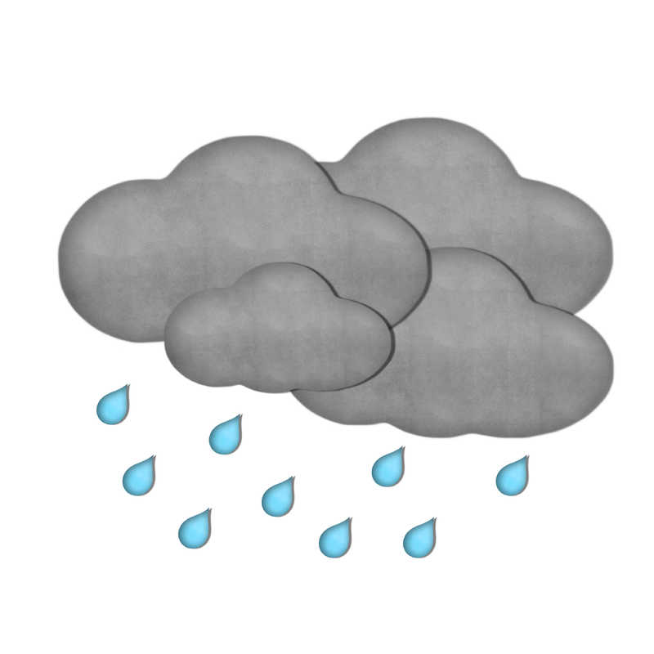
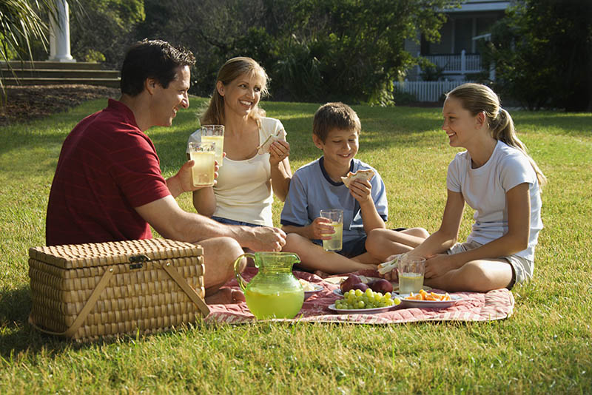
We ____________________ when it __________________.
were having a picnic
started to rain
we
it
start to rain
have a picnic

Slide 11
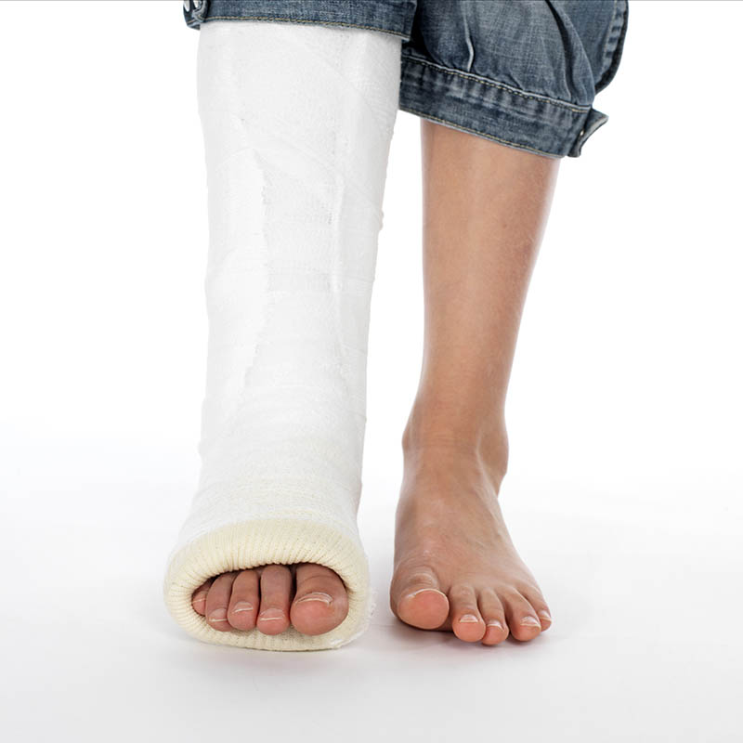
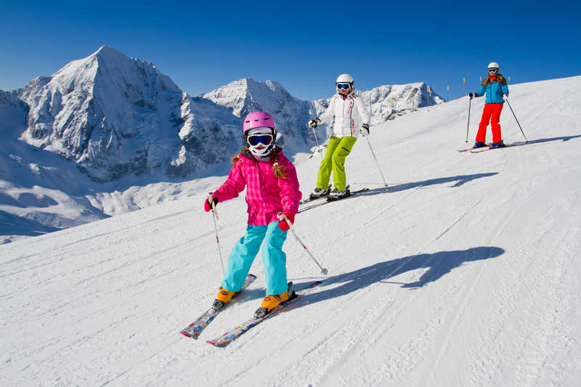
The girl ________________ while she _____________.
broke her leg
was skiing
the girl
ski
break her leg

Slide 12
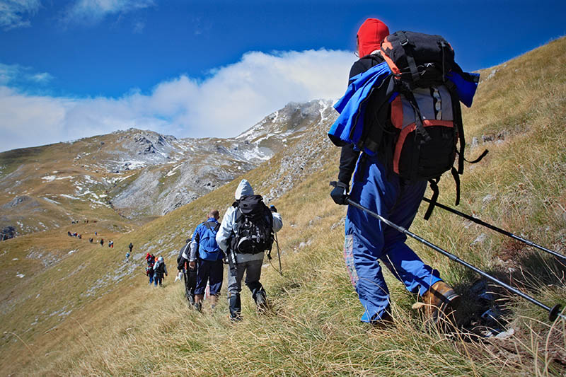
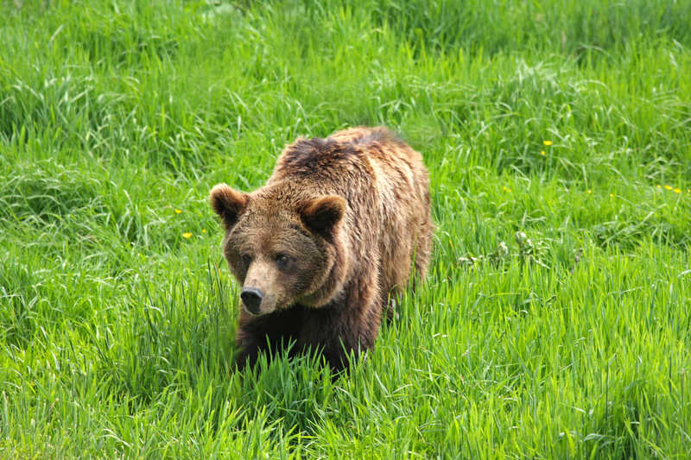
They ________________ when they _____________.
were hiking
saw a bear
they
hike
see a bear

Slide 13
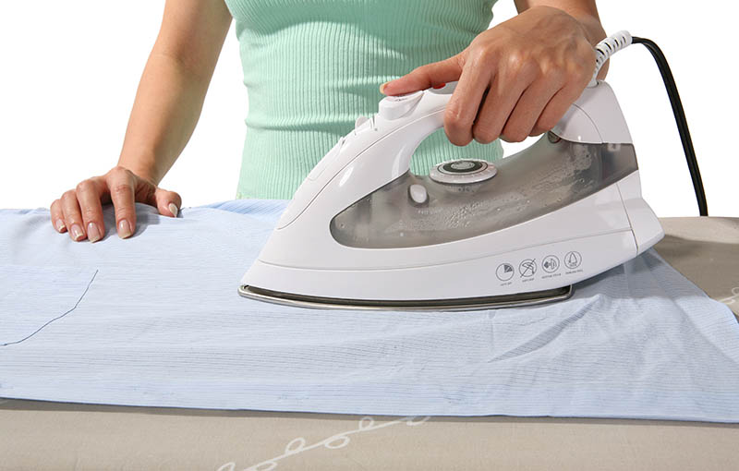
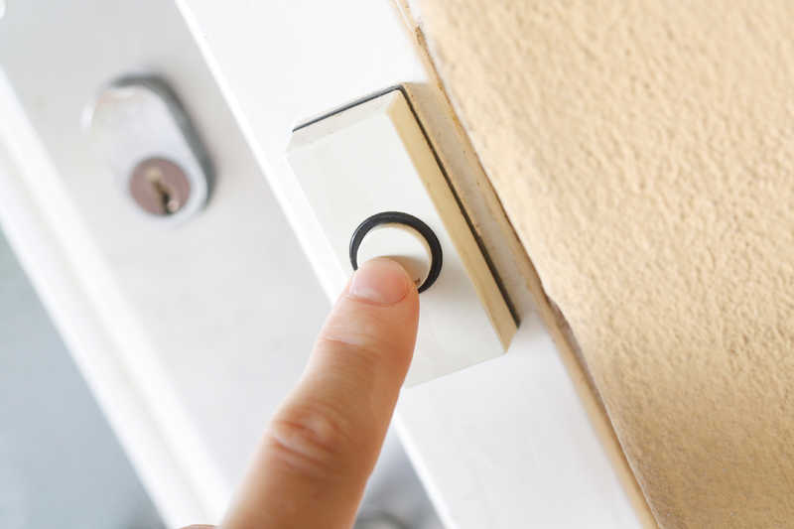
Susan ___________________ when she _________________ ringing.
was doing the ironing
heard the doorbell
Susan
do the ironing
hear the doorbell

Slide 14
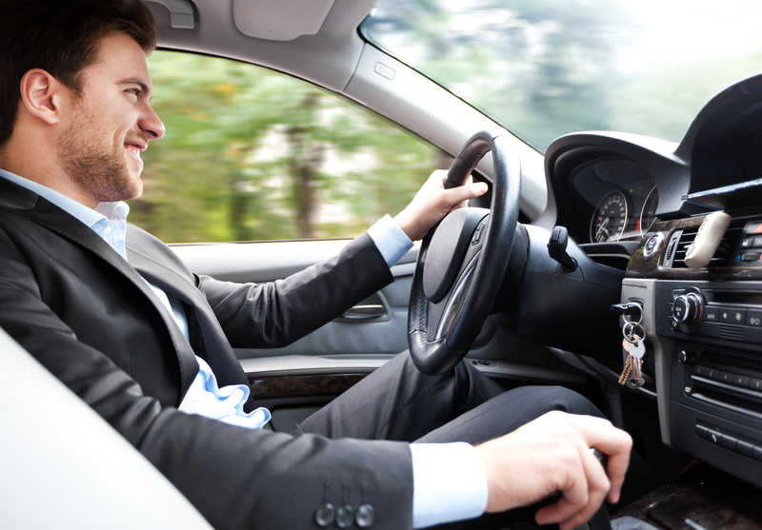

As Harry __________________, the policeman ____________.
was driving too fast
stopped him
Harry
the policeman
drive too fast
stop him

Slide 15

Use the Past Continuous for a longer past action interrupted by a shorter action. Use the Simple Past for the shorter action.
I was sleeping when you called me.

